Slide 1
Elementary
These slides are most suitable for grades K-3

Slide 2
Renewable Energy

Slide 3
Answer these questions…
What is Energy?
What types of Energy are there?
What’s your favorite type of Energy?

Slide 4
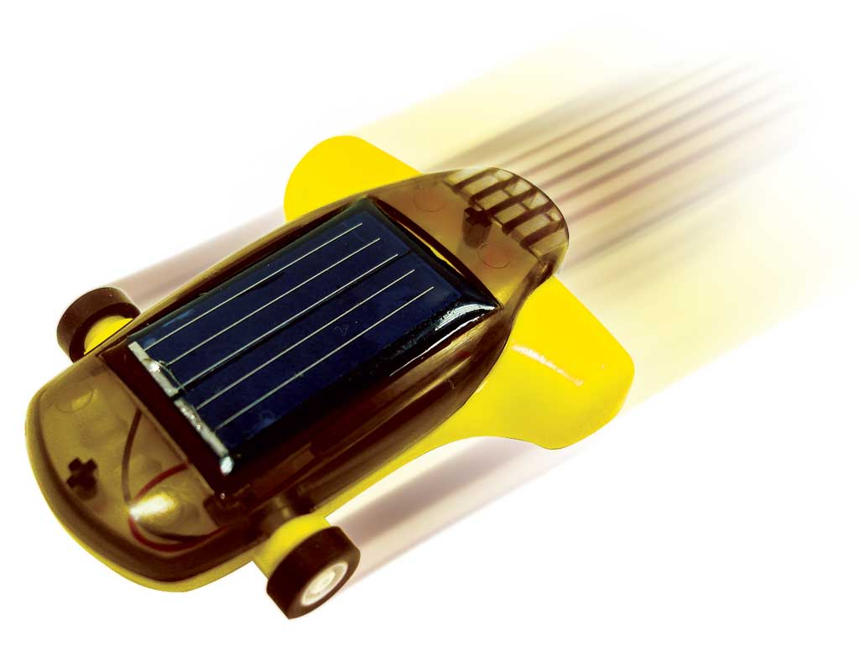
Let’s talk about some of the more common (and visible forms) of energy
Kinetic Energy
Where have you seen this?
Wind Turbines
Nozzles and Diffusers
Potential Energy
Where have you seen this?
Pumps
Hydroelectric Plants

Slide 5
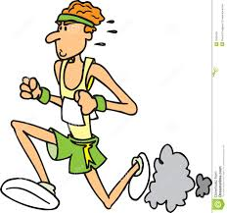

Kinetic Energy
Energy that a system or body has because it is in motion, is called kinetic energy (KE).
Energy associated with mass(kg) and velocity(m/s)!
$KE=m\frac{V^{2}}{2}$ (kJ)

Slide 6
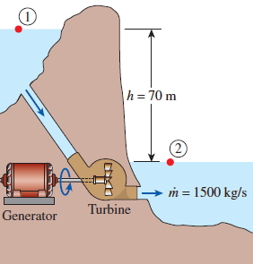
Potential Energy
This is the energy that a system has because of elevation
The water on one side of the hill is higher than on the other. That means the water on the left has Potential Energy that could be used.
Someone put a Turbine in between the two sides to capture some of that energy
$PE=m∗g∗h$ (kJ)
$$m=mass$$
g= gravitational constant (9.81 m/s²)
h = is the height relative to a reference point

Slide 7
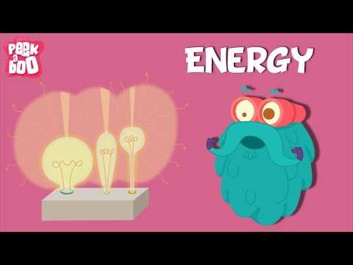

Slide 8
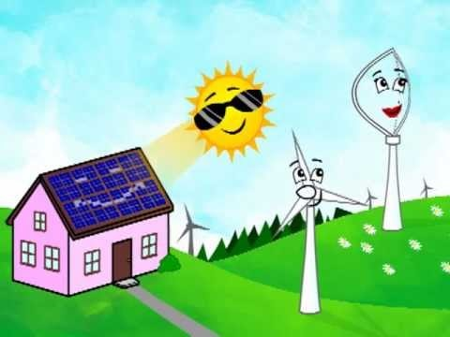

Slide 9
Additional Videos
https://www.youtube.com/watch?v=ndWIMYzv3aE Windy and Friends
https://www.youtube.com/watch?v=nrlaSjGqDqI Sunny and Friends

